Slide 1


Getting the best
Out of SERVICE-LEARNING

Slide 2
Learning Objectives
Understand the S-L Implementation Stage
Reflective Cycle, Gibb
Learning Objectives of S-L
DEAL Reflection Model, Ash, S. L., & Clayton, P. H.
Bloom Taxonomy
SkillsFuture - Generic Skills & Competencies for Infocomm Technology

Slide 3
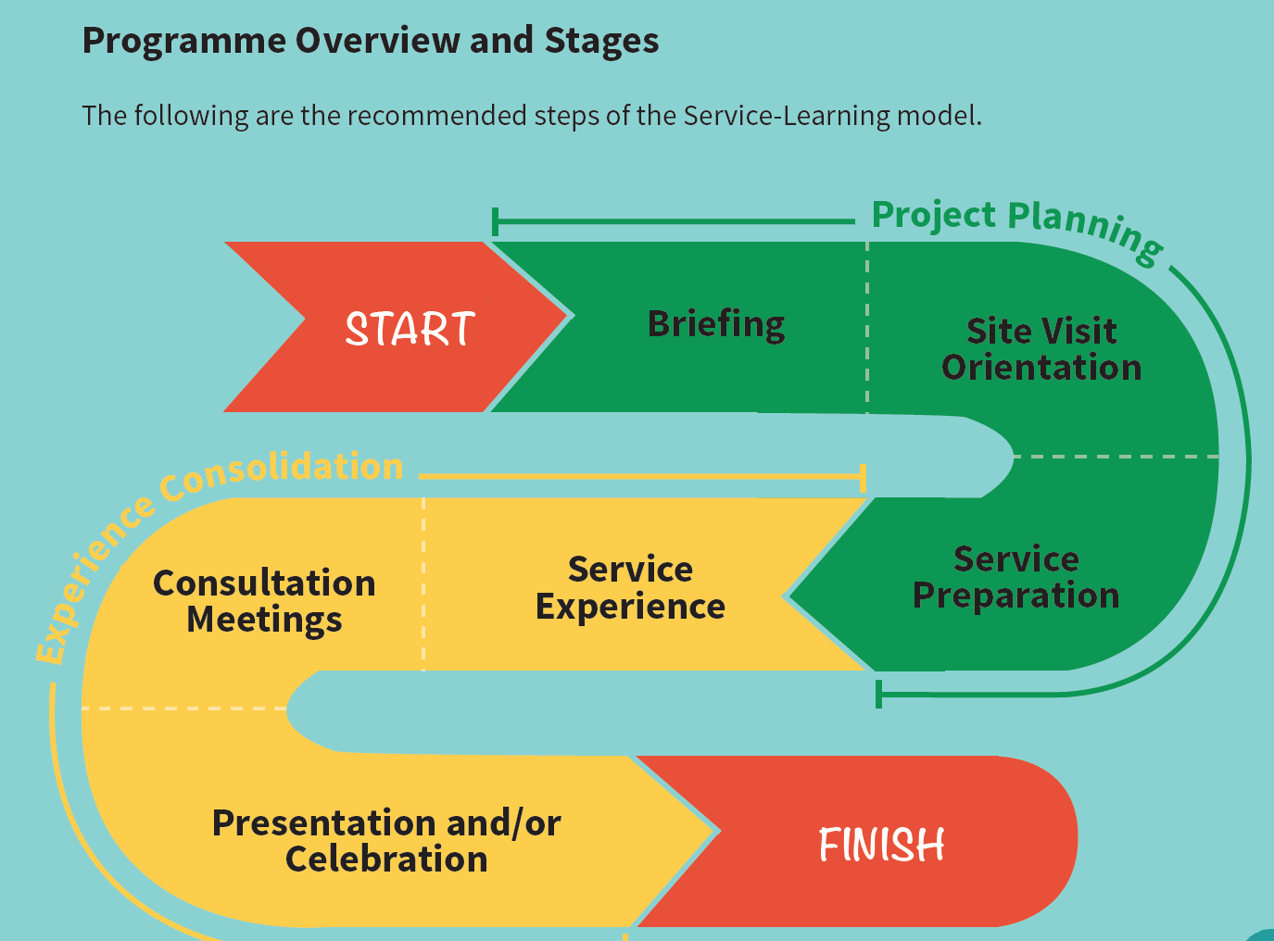
Implementing Service-Learning

Slide 4
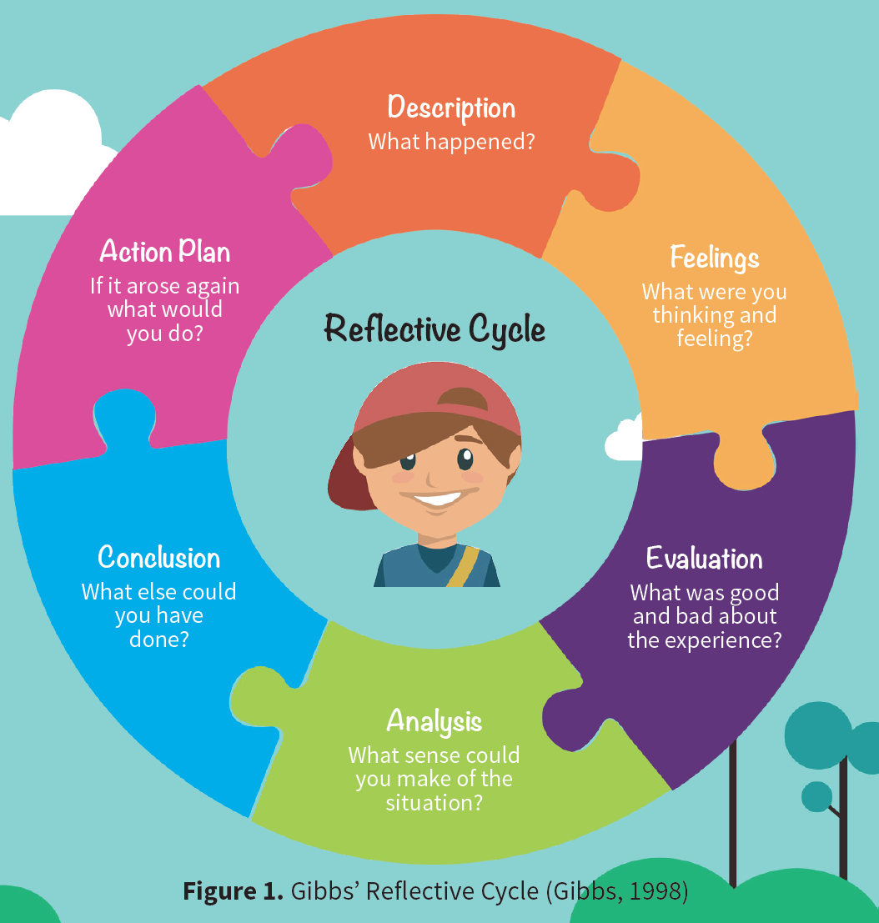
Reflection – Reflective Cycle
Good reflection links service and learning, is structure by learning objectives, occurs regularly, provides opportunities for feedback and allows students to consider civic and social values.

Slide 5
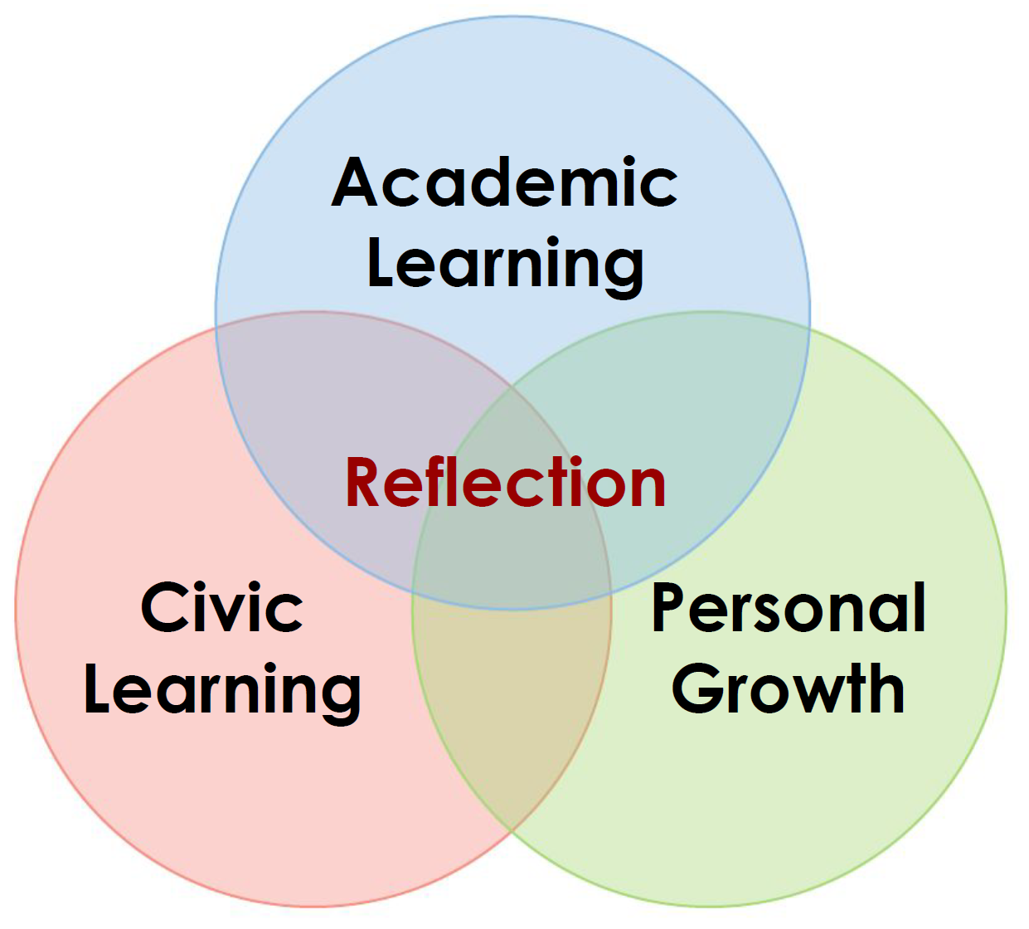
Learning Objectives of S-L

Slide 6
DEAL Reflection Model Ash, S. L., & Clayton, P. H. (2009)
What
Describe
What? When? Where? Who? Why?
Examine
Reflection prompts by categories of learning objectives based on 6 levels from Bloom Taxonomy
Learning Objectives
So What
Academic
Learning
Civic
Learning
Personal Growth
Articulate Learning
What did I learn? I learnt that ….
How did I learn it? I leant this when ….
Why is it important? This learning matters because…
What will i do because of it? In light of this learning, in the future I will …
Now What

Slide 7
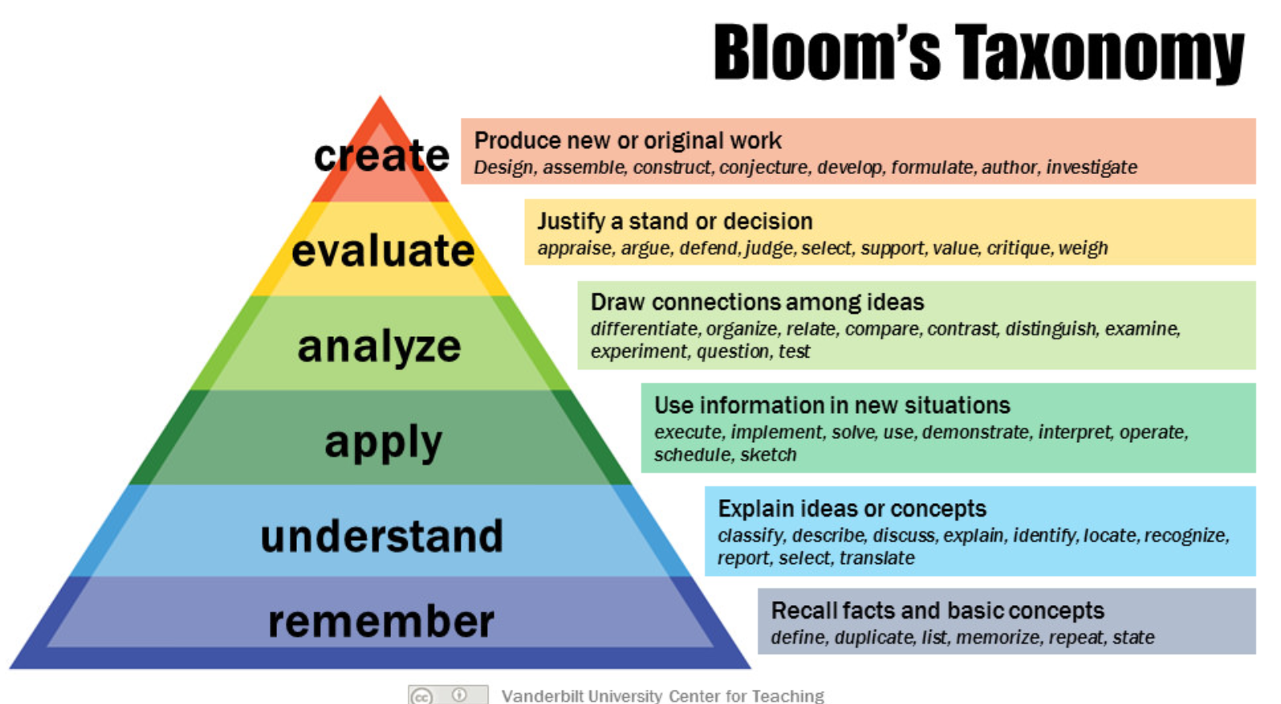
6 Levels
Notes:
Bloom’s Taxonomy. (2010). Vanderbilt University. Retrieved from https://cft.vanderbilt.edu/guides-sub-pages/blooms-taxonomy/

Slide 8
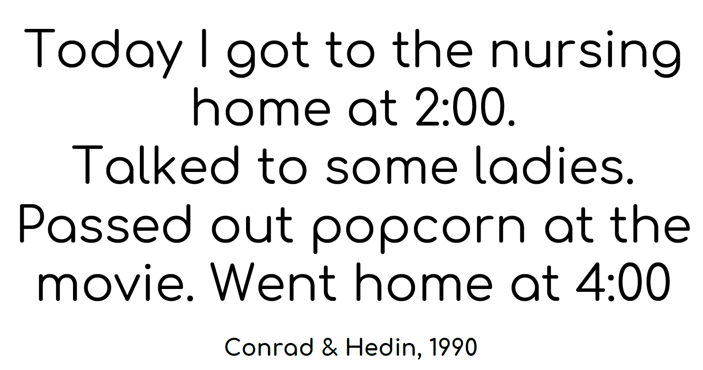
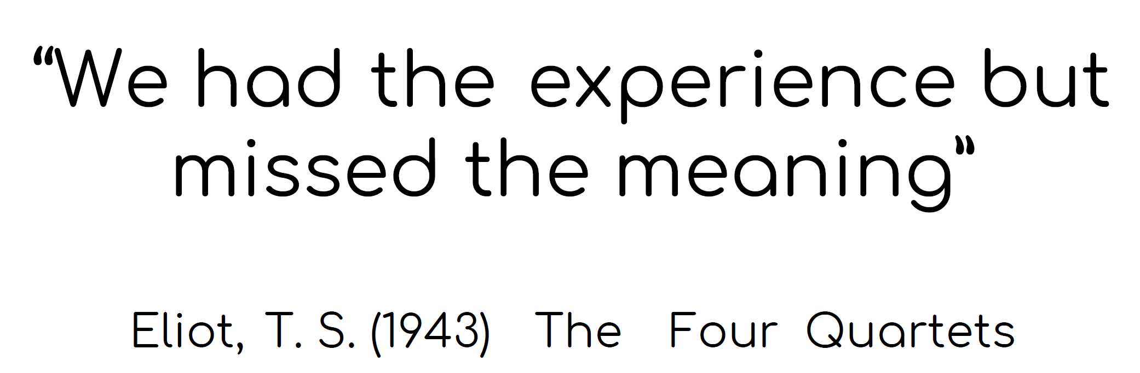
Reflection – Example 1

Slide 9
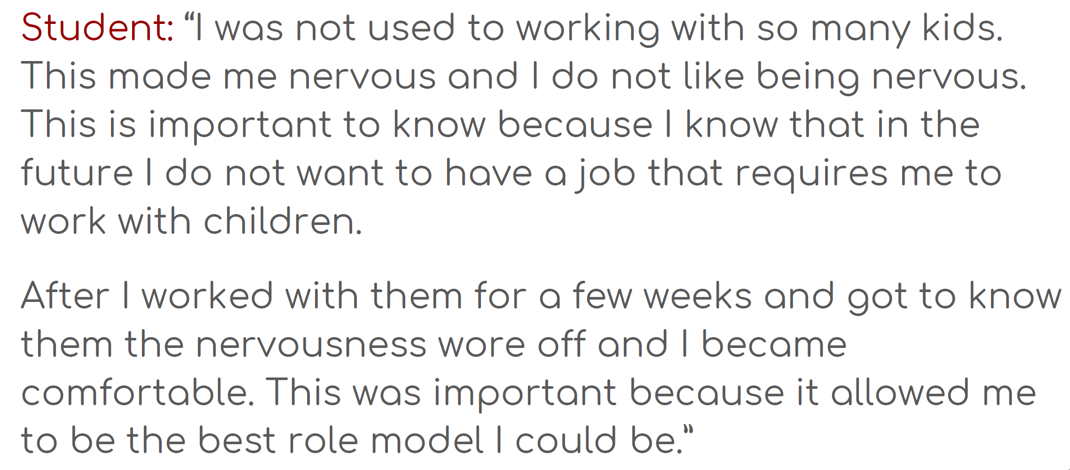
Reflection – Example 2

Slide 10
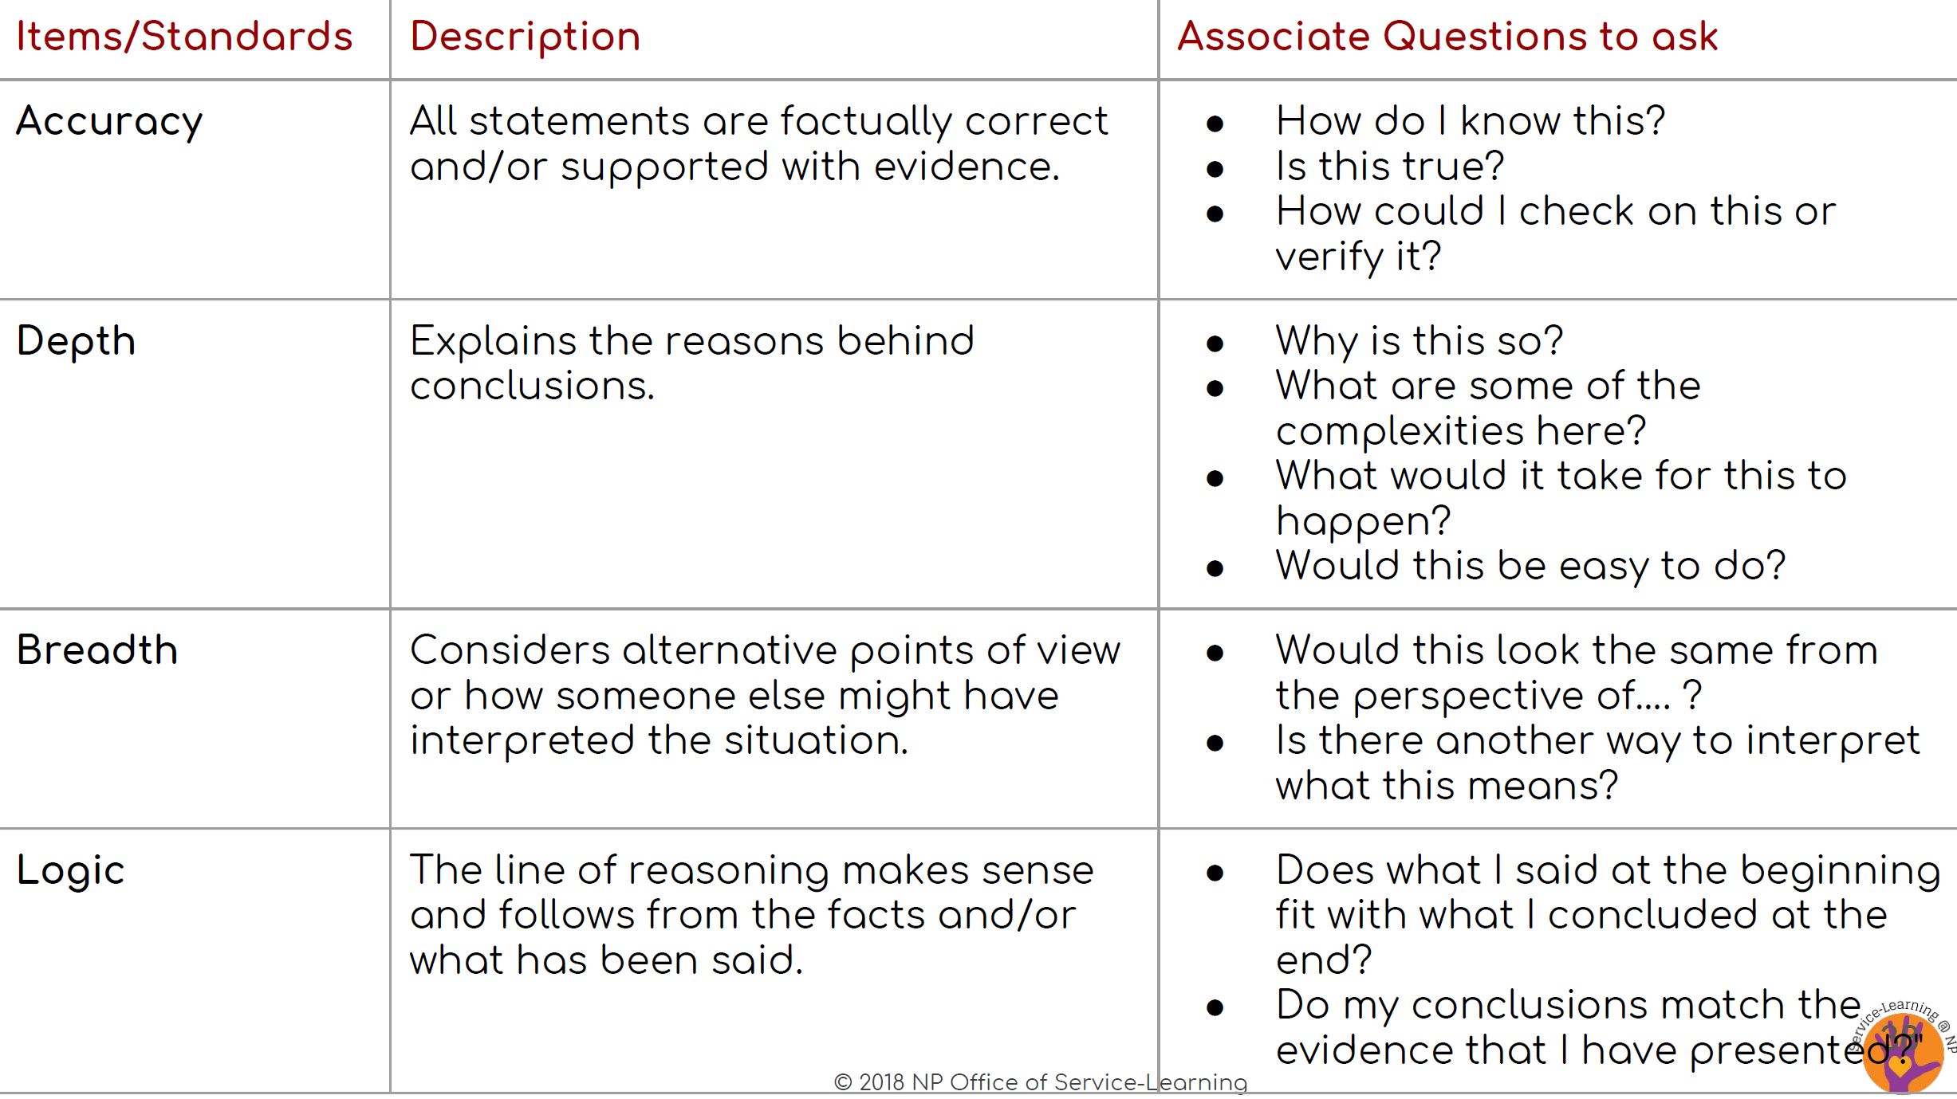
4 Critical Thinking Standards

Slide 11
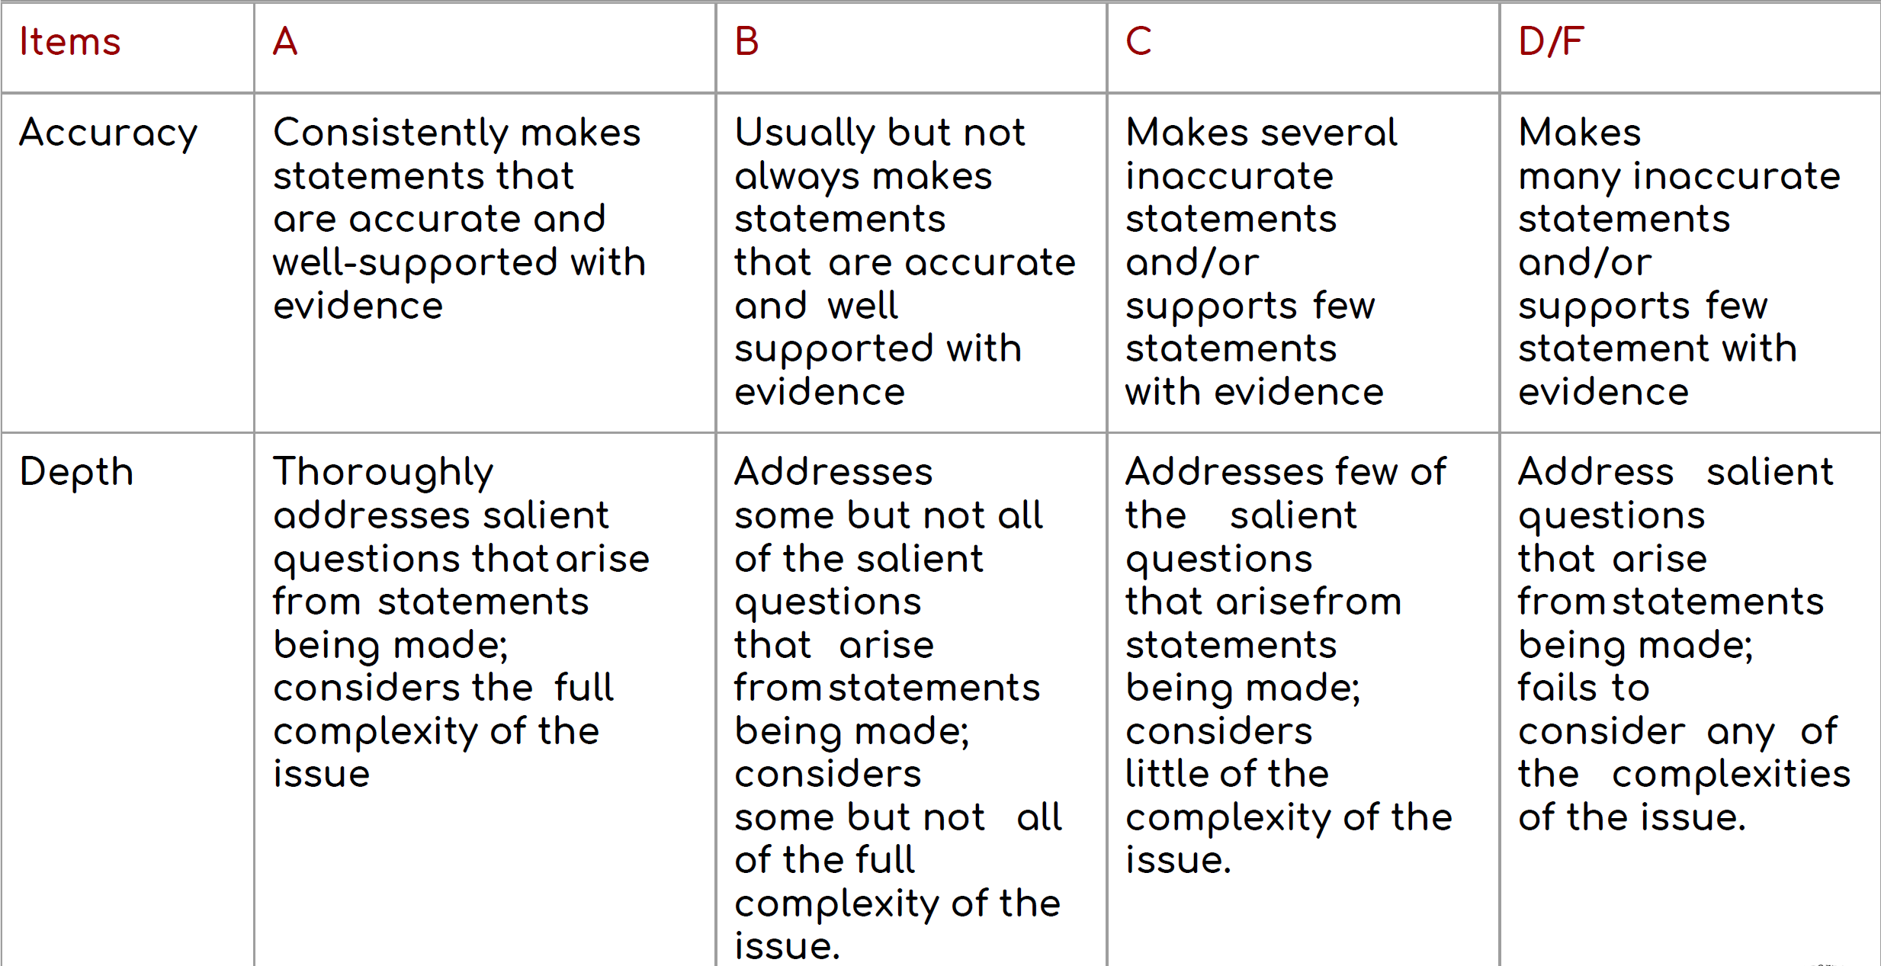
Example of Assessment Rubric

Slide 12
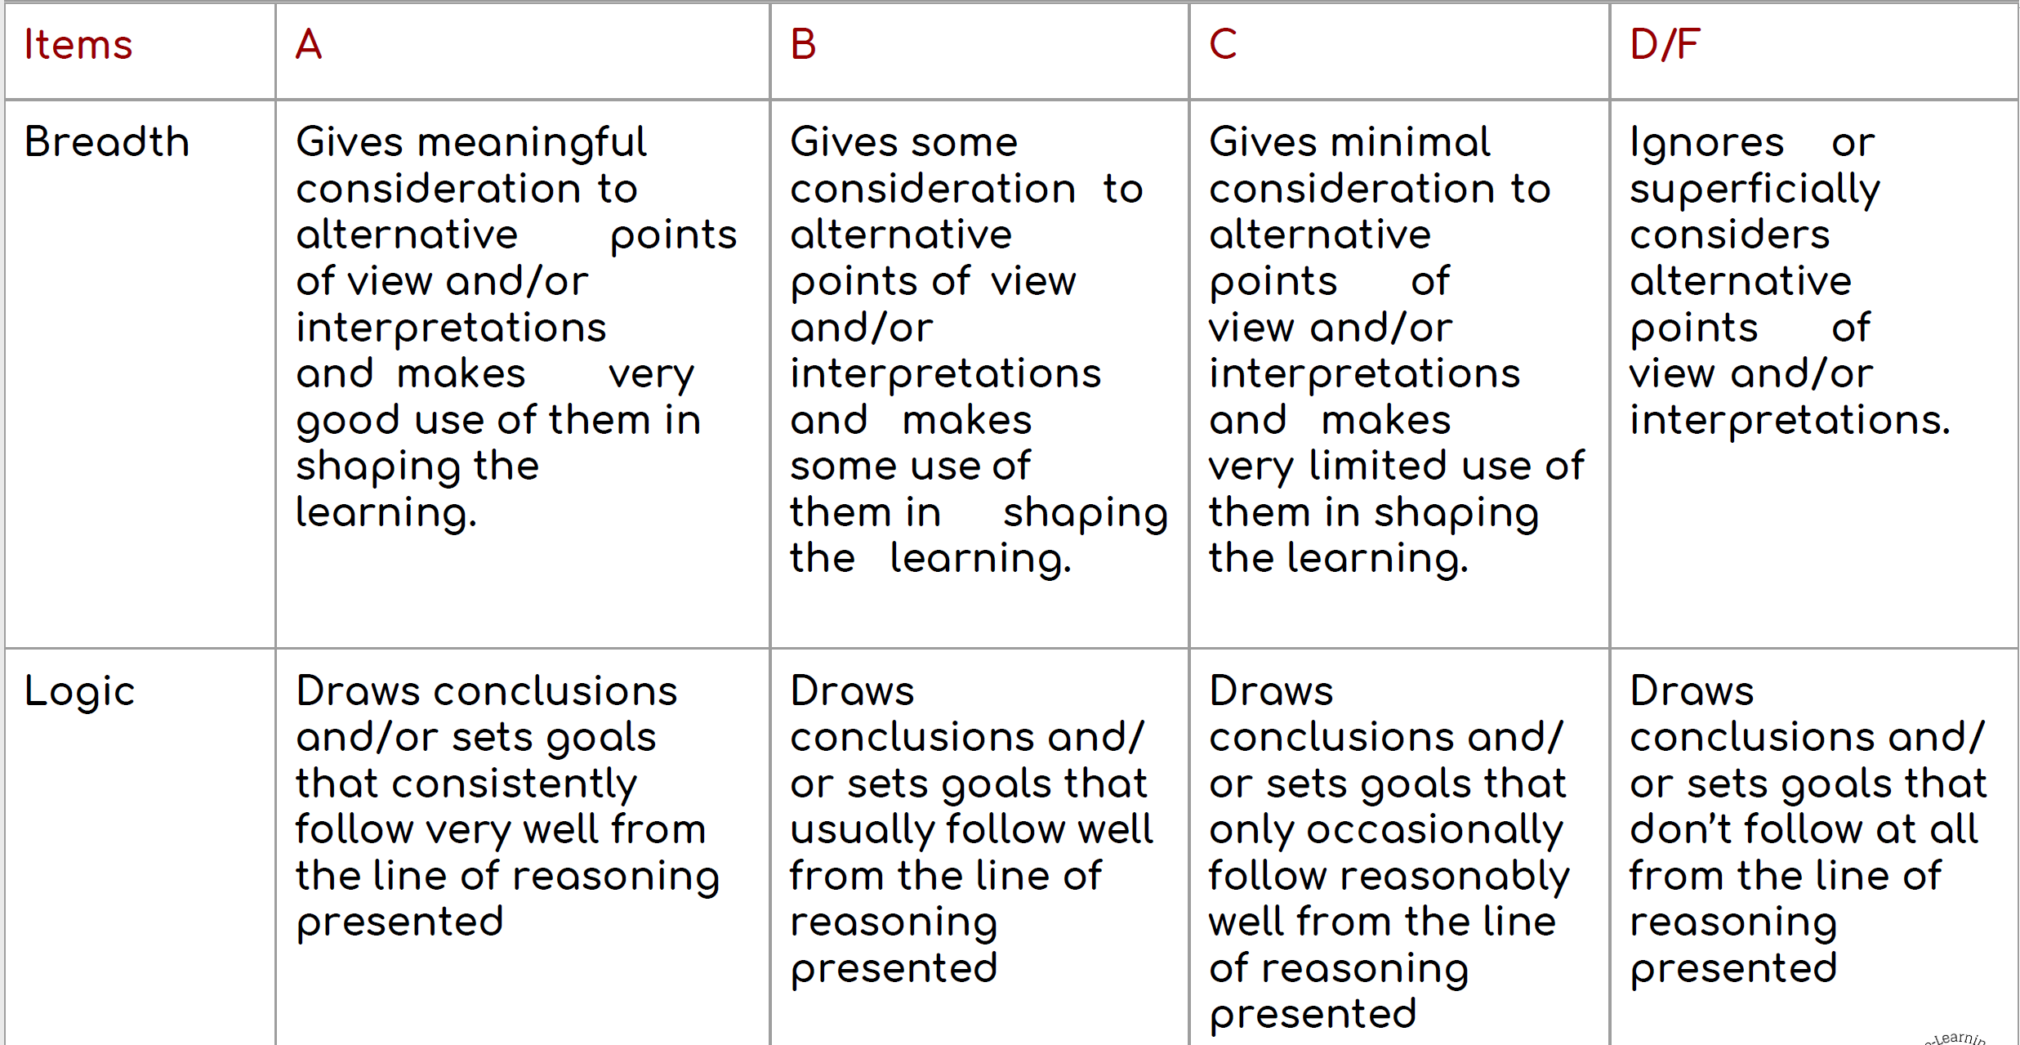
Example of Assessment Rubric

Slide 13
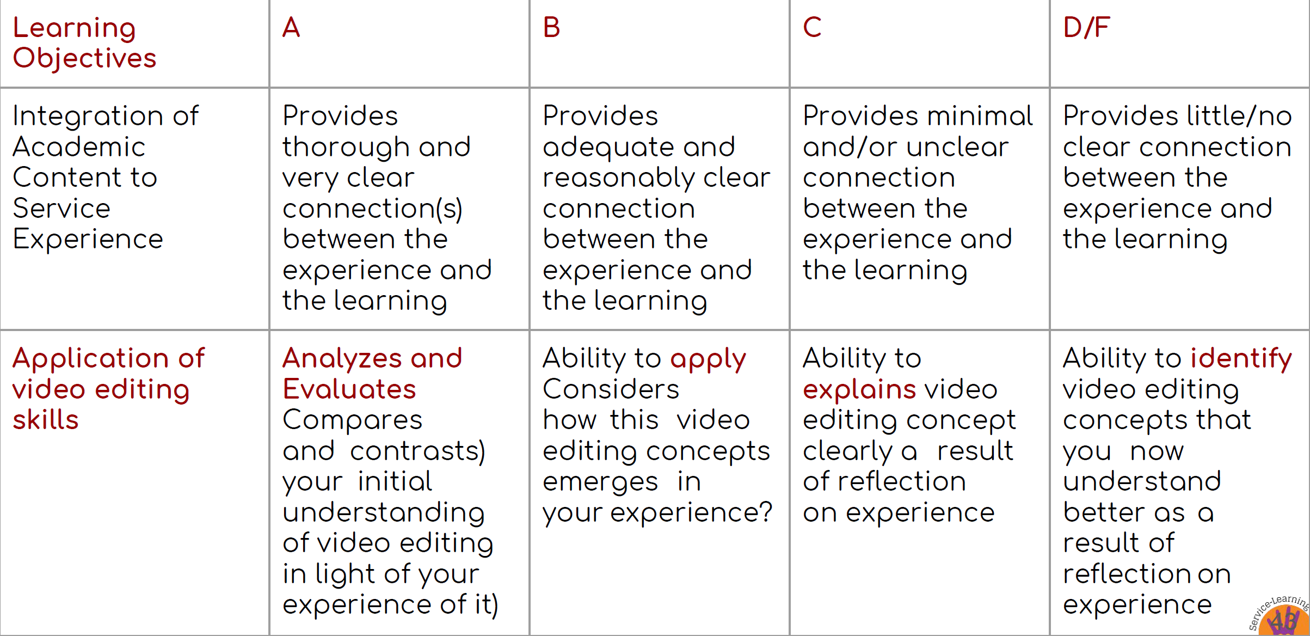
Example – Academic Learning

Slide 14
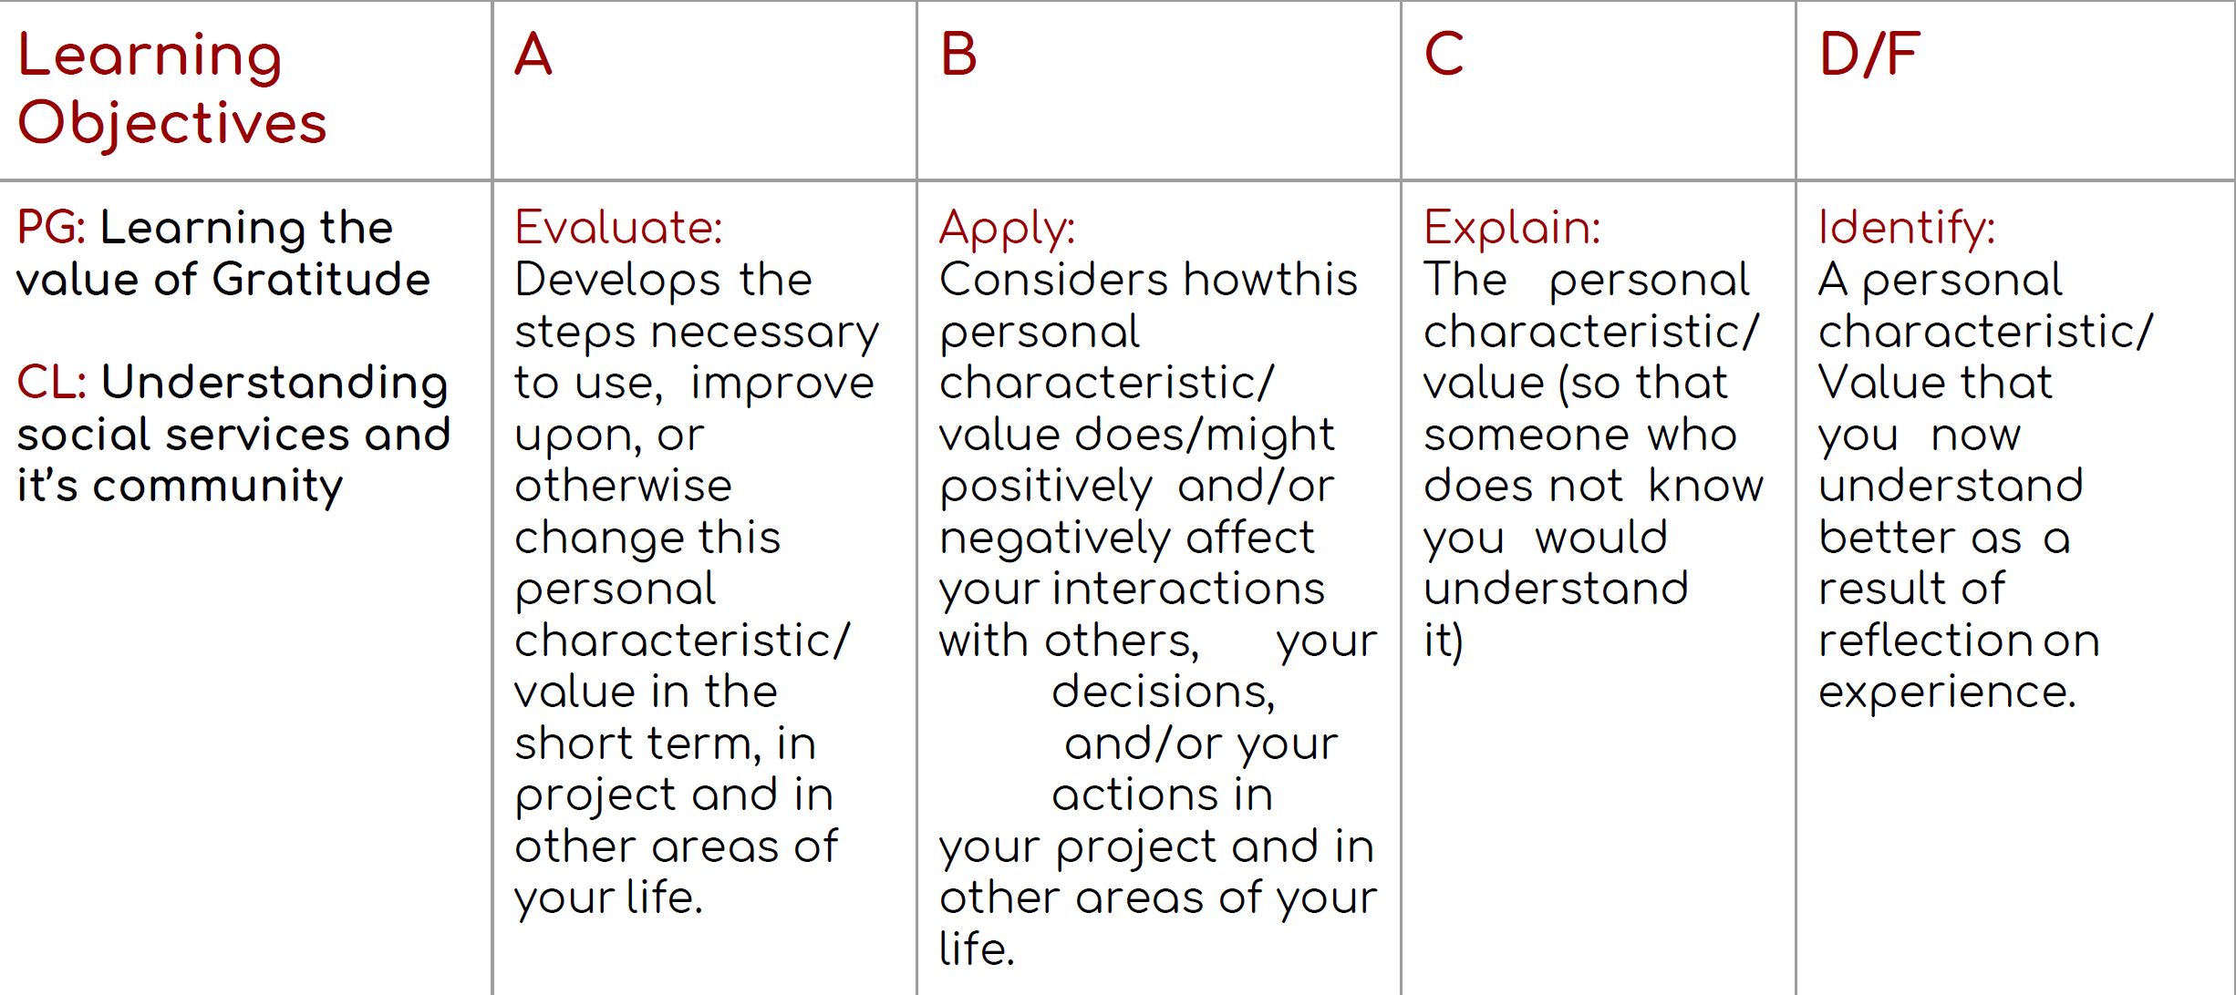
Example – Personal Growth and Civic Learning

Slide 15

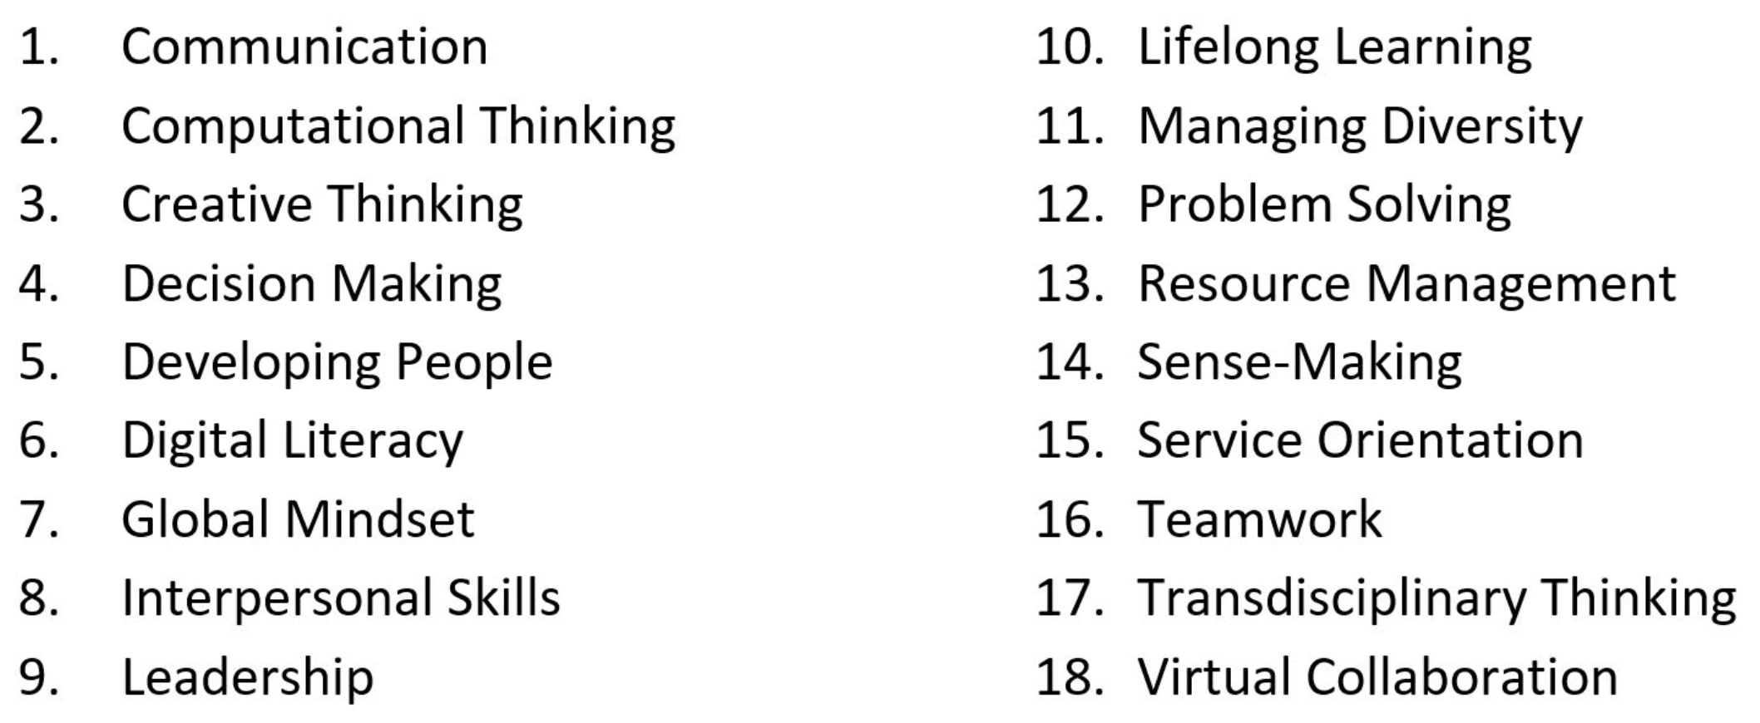
Generic Skills & Competencies for Infocomm Technology
Notes:
http://www.skillsfuture.sg/skills-framework/ict#howcanibenefitfromit

Slide 16
Pre-trip Reflection
I am going for this service project because ….. (why did I go for this training?)
My perception and understanding of the beneficiaries that I am going to serve before meeting and serving the beneficiaries (how well you understand about the beneficiaries and VWO?)
I will need to do/think/consider …. when working with someone with the community (describe what you need to do/think/consider and explain why)
I feel …. excited/worried/scared/concerned (state your feelings) knowing that I am going to work with someone from the community that I don’t know. (examine your feelings and explain why)
For this project, I can contribute by … (examine your skills, ability, interest, strength and weaknesses that are needed to contribute and why)

